Slide 1

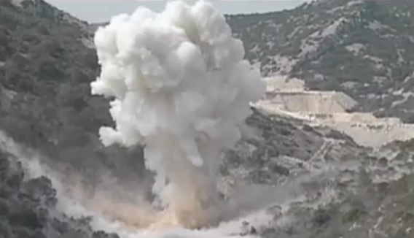

Structure and mechanical properties of explosive welded Mg / Al bimetal
Institute of Materials Research SAV Košice,
Slovak republic
Dušan Balga et al.
| 2014 |
Notes:
Good afternoon Ladies and Gentlement, Let me introduce myself, my name is Dušan Balga, I´m from institute of Materials Research of Slovak academy of Sciences from Košice.
In today´s presentation I´d like to talk about Structure and mechanical properties of explosive welded Magnesium – Aluminium bimetal.

Slide 2
Outline
our material
metallography
optical profilometry
SEM / EDX
microhardness
hard X-ray micro-diffraction experiment
  phase analysis
  computation of lattice parameters of Al and Mg
conclusion
Notes:
My talk is divided into seven parts, firstly I will tell you general informations about our material, then I will characterise it from the viewpoint of experimental techniques like metallography, optical profilometry, SEM analysis and microhardness and finally hard X-ray micro-diffraction experiment will conclude my speech.

Slide 3
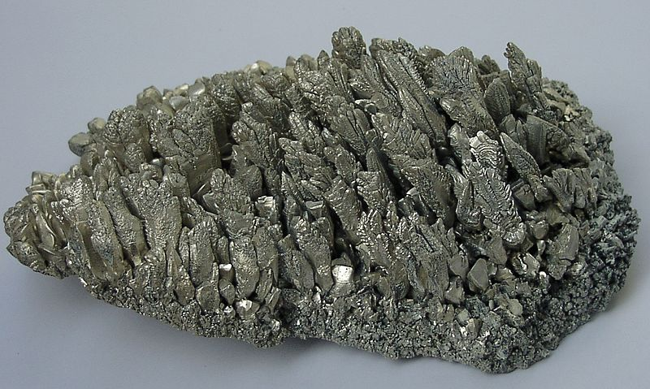
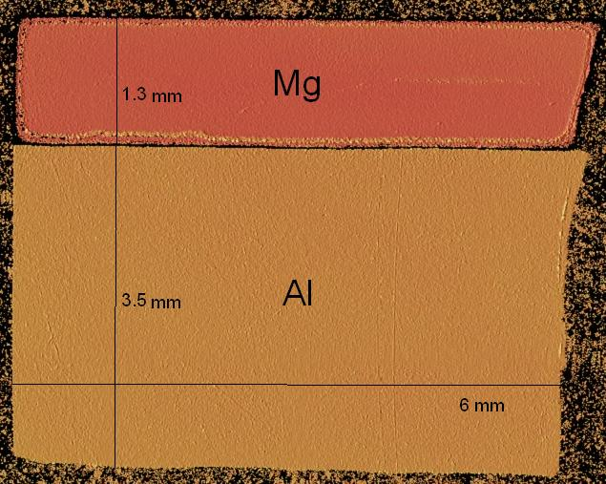
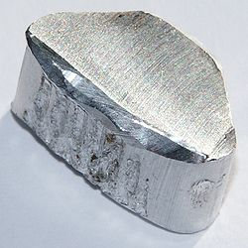
Mg / Al bimetal
Mg:
lightest among metallic materials
density is about 2/3 of that of aluminium
recycled without any degradation in physical properties
Al:
corrosion resistance
high strength to weight ratio
good formability
manufacturer: EXPLOMET, Poland
Cooperation and word of thanks:
  prof. Ing. Eva Mazancová, CSc.
  Ing. Dmytro Ostroushko
  VŠB-Technical University of Ostrava, Czech republic
Combination of Mg and Al would be promising structural material (aerospace, automobile industry)
Notes:
Let´s start with som informations about our material. ..One of the criterions of the industry for materials selection is high strength to weight ratio with the requirement of economical production and enviroment protection. Magnesium is the lightest among metallic materials used in industry, it’s density is about 2/3 (two – thirds) of that of aluminium and can be recycled without any degradation in physical properties. Aluminium offers corrosion resistance, good formability and high strength to weight ratio so the combination of these two materials in the form of laminates seems to be a promising <promising> structural materials meeting requirements of the manufacturers <nanjufak...> and offering combination of the properties of both materials.
Our bimetal sample with a length of approximately 6 mm and width of 4.8 mm was made by explosion welding of commercially available magnesium <magnízium> and aluminium <aljuminium>. The thickness of Mg plate is 1.3 mm, Al has 3.5 mm in width.
We obtained this sandwich thanks to cooperation with Prof. Eva Mazancová and Ing. Dmytro Ostroushko from Vysoká śkola Báňská, technical university of Ostrava

Slide 4
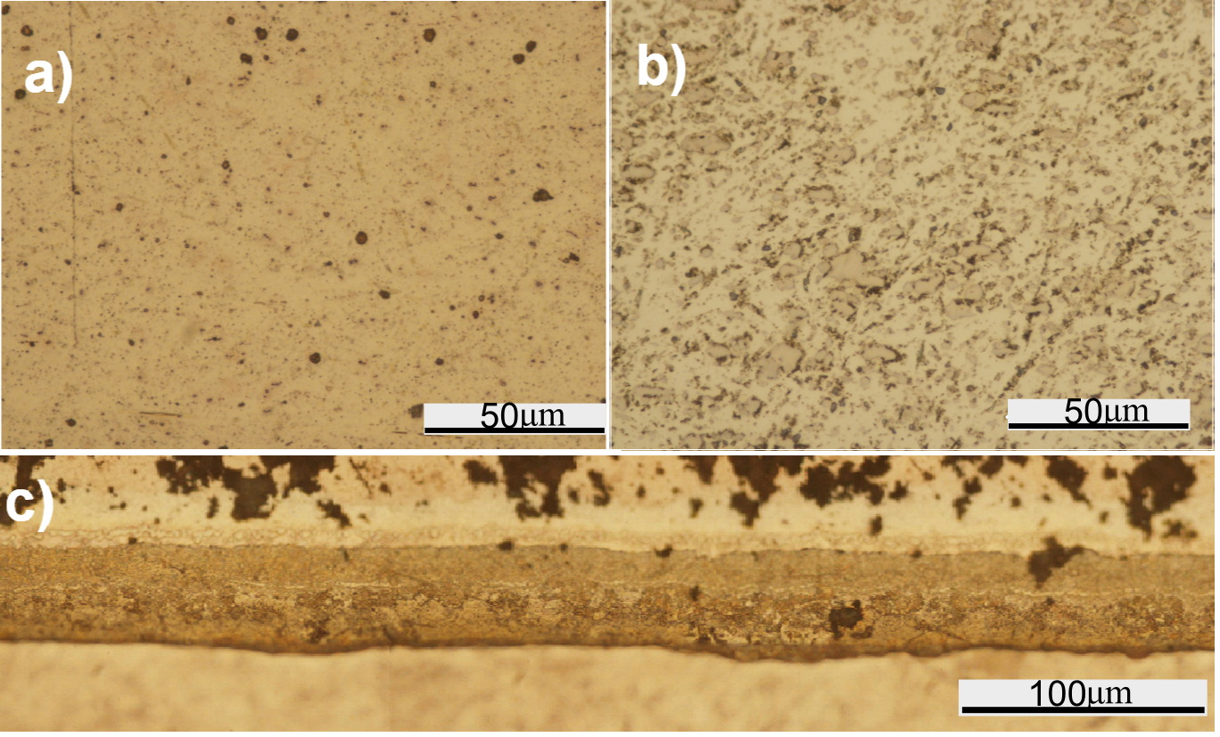
Metallography
average thickness of the interface 45 microns
Notes:
Now let´s start with metallography – the specimen was embedded in IsoFast thermosetting resin (Struers GmBH) at a pressure of 28 MPa and a temperature of 170 (one – hundred seventy degrees)°C. The sample was grounded and polished with colloidal silica suspension with a grain size of <ziro point> 0.05 microns.
Figure a) <ej> and b<bí> show the microstructre of magnesium and aluminium respectively at magnification of 1000 (one thousand) X It consists of elongated and spheric grains of various phases.
Figure c) illustrates the joint between Mg and Al at magnification of 500 (five hundred) x. We made in total 10 optical micrographs from the interface region with aim to evaluate average thickness of the interface (bond) we found it in all micrographs almost the same ~ 45 microns wide.

Slide 5
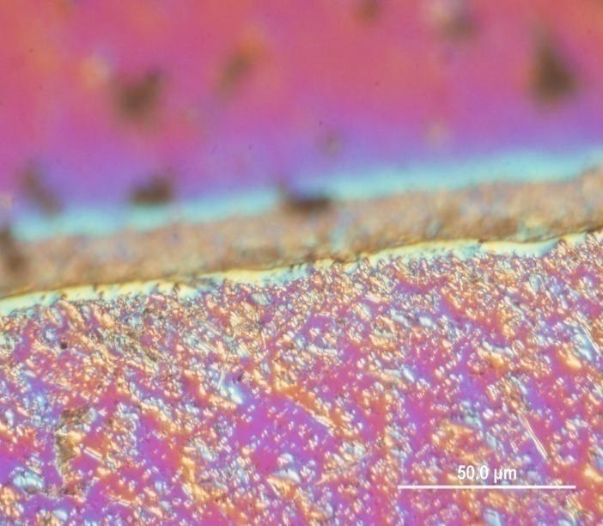
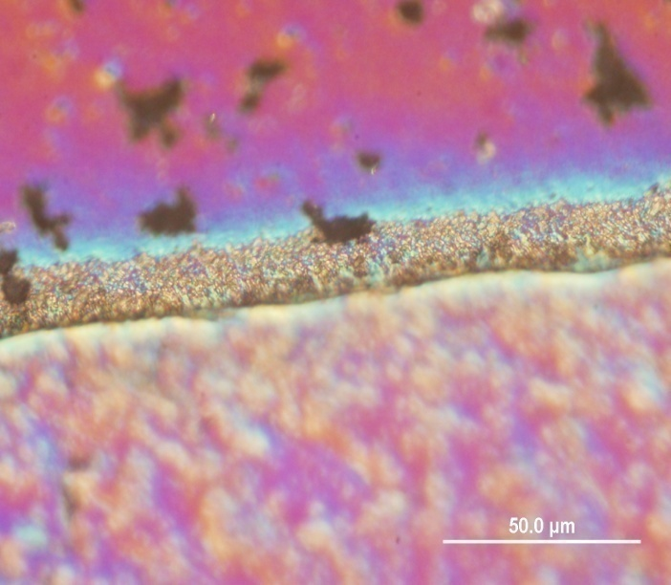
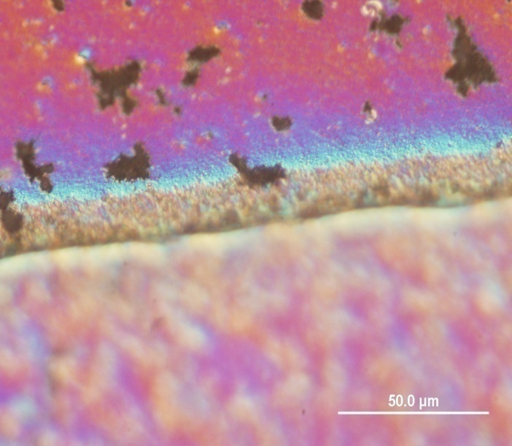
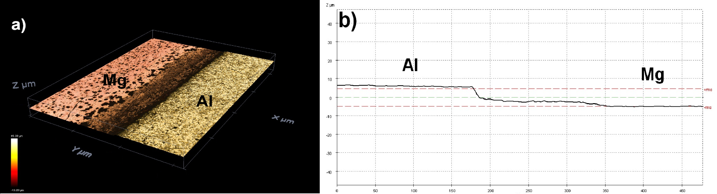
Optical profilometry
the difference is approximately 8 microns (Al higher)
Notes:
One interesting observation from our light optical microscopy was we were not able to focus image simultaneously on both materials which can bee seen on the top of the slide.
The reason is of course height difference between Mg- (lower) and Al- (higher) planes. The height difference value was revealed by 3D Optical Profiler SENSOFAR PLu neox. The <av:ridž> averige difference is approximately 8 micron depending on the position of the measurement.

Slide 6
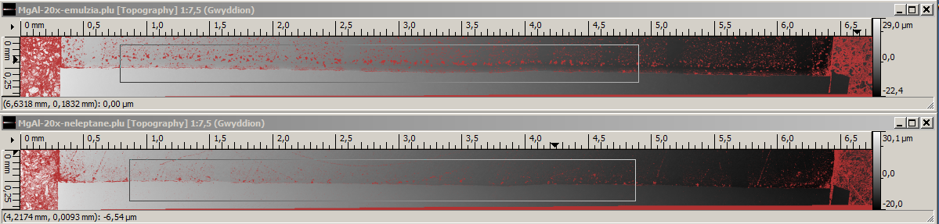
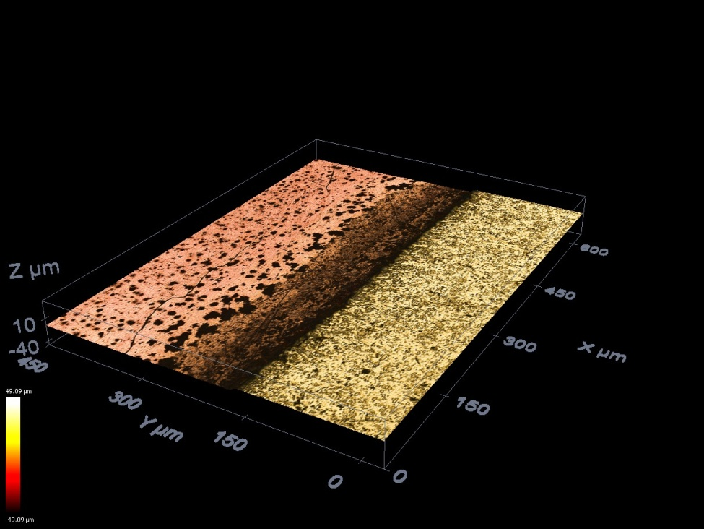
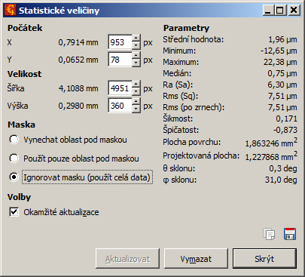
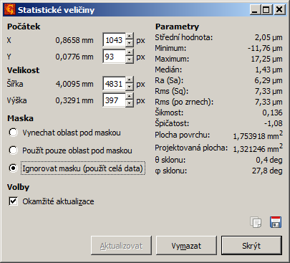
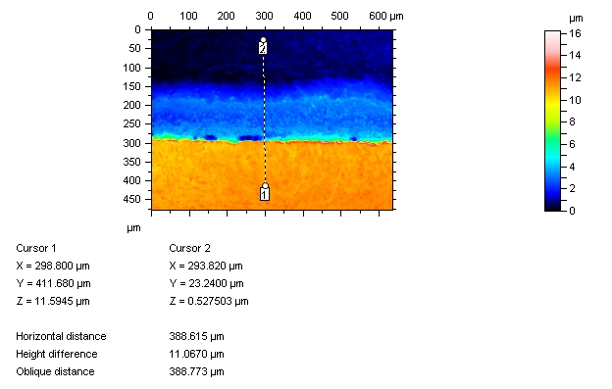
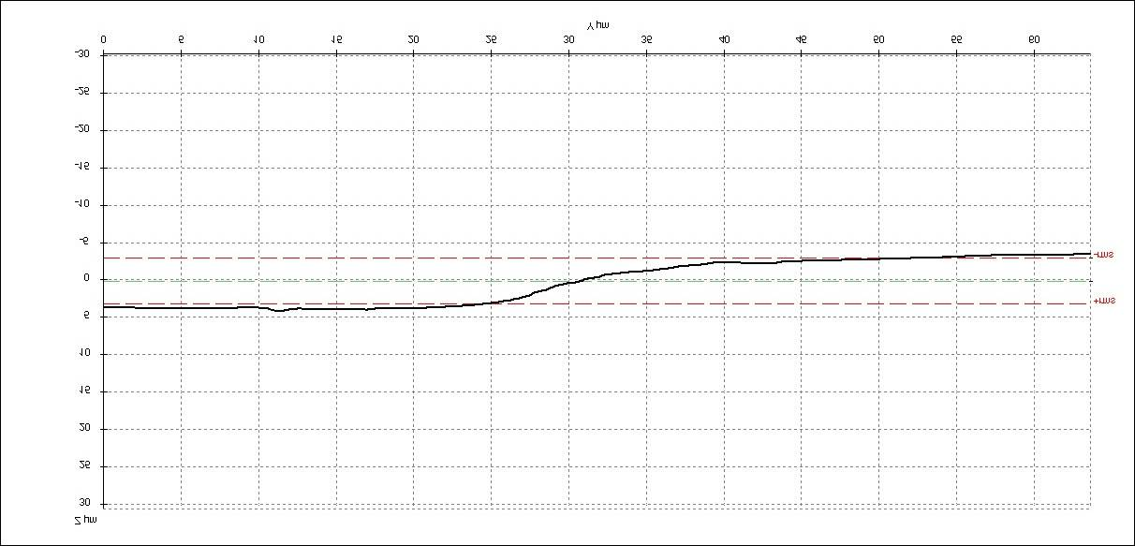
Optical profilometry
Notes:
We made several efforts to change the procedure of sample preparation (it does mean various grinding papers, polishing clothes and suspensions) but the result was almost <olmoust> the same as you can see on statistical values from the analysis of profiles polished with and without silica suspension. So the conclusion is that sample preparation procedure didn´t influence the value of height difference in any substantional manner and the difference is caused simple due uneven hardness of investigated materials.

Slide 7
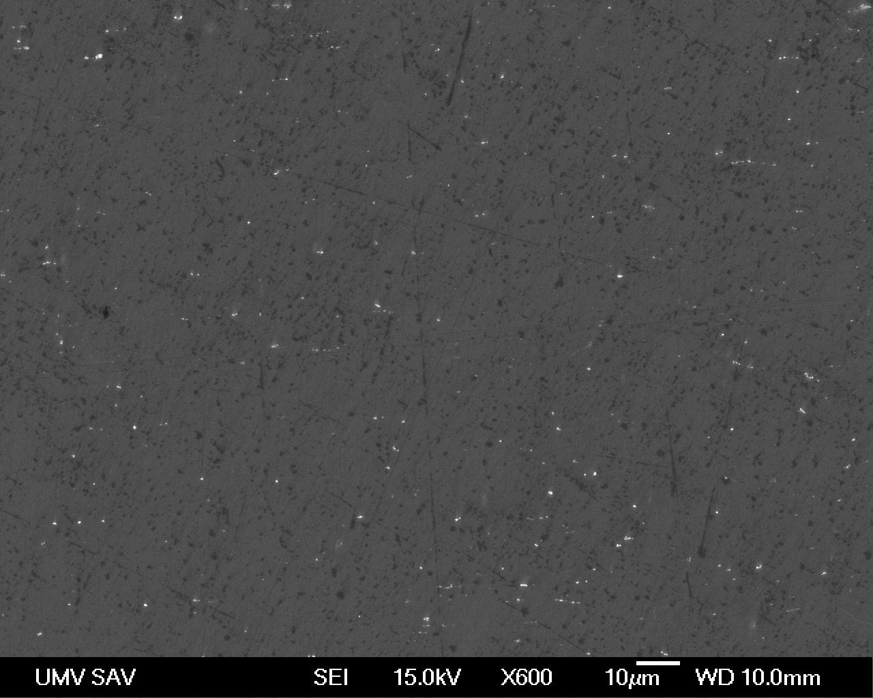
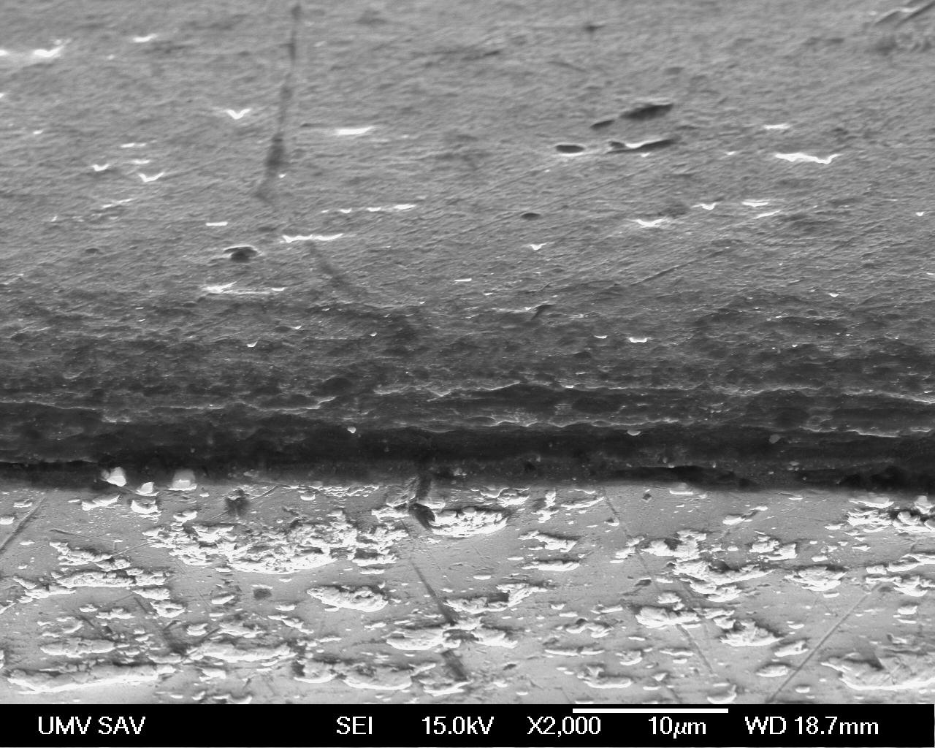
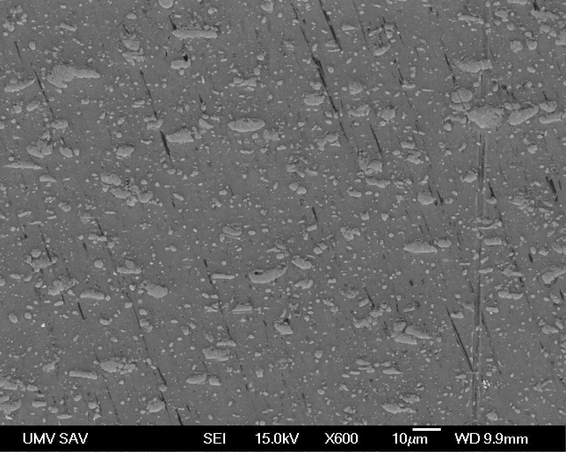
SEM/EDX
Mg
Element | Weight% | Atomic%
O K | 1.49 | 2.25
Mg K | 98.31 | 97.58
Si K | 0.20 | 0.17
weld, tilt of the specimen 70°
Mg
Al
Al
Element | Weight% | Atomic%
O K | 0.98 | 1.73
Al K | 90.04 | 94.28
Cu K | 8.98 | 3.99
Notes:
Now I’d like to move on to Scanning electron microscopy. On the left side is microstructure of Magnesium and Aluminium at magnification of 600X . We were interestied in the purity of materials. Chemical composition of welded materials were determined by EDX microanalysis measured far away from the interface region. Chemical composition is varying with the majority of elements corresponding to Mg and Al. If you look at the tables in magnesium we identified Silicon and Oxygen and in Aluminium it was Copper and Oxygen.
On the right side you can see the morphology of the welded joint at magnification of 2000X where specimen was tilted to 70° <seventy degrees>for getting better contrast.

Slide 8
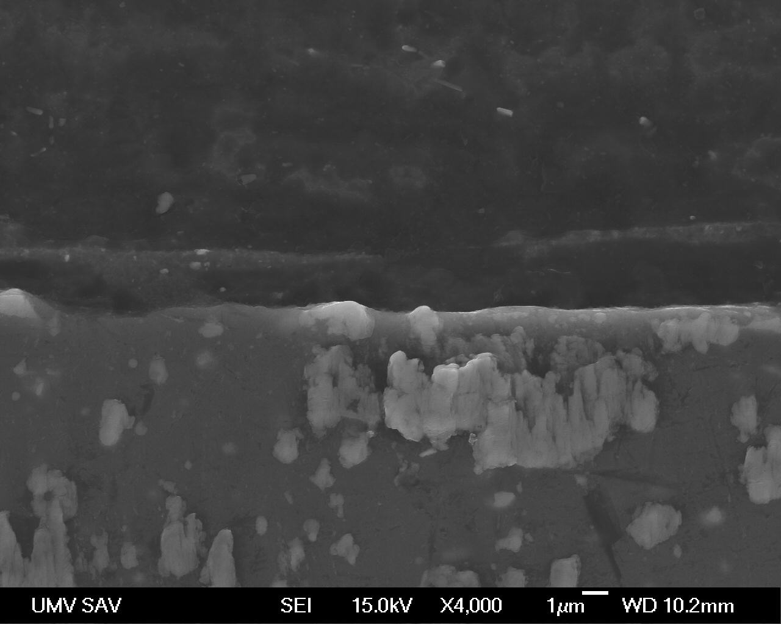
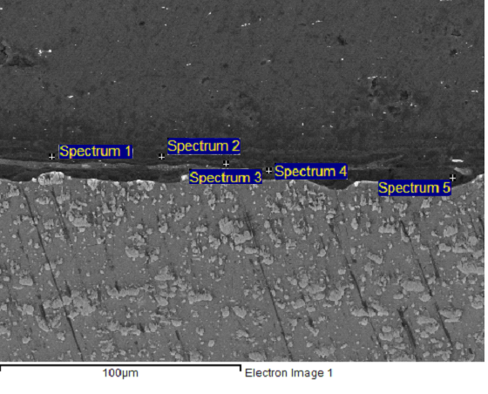
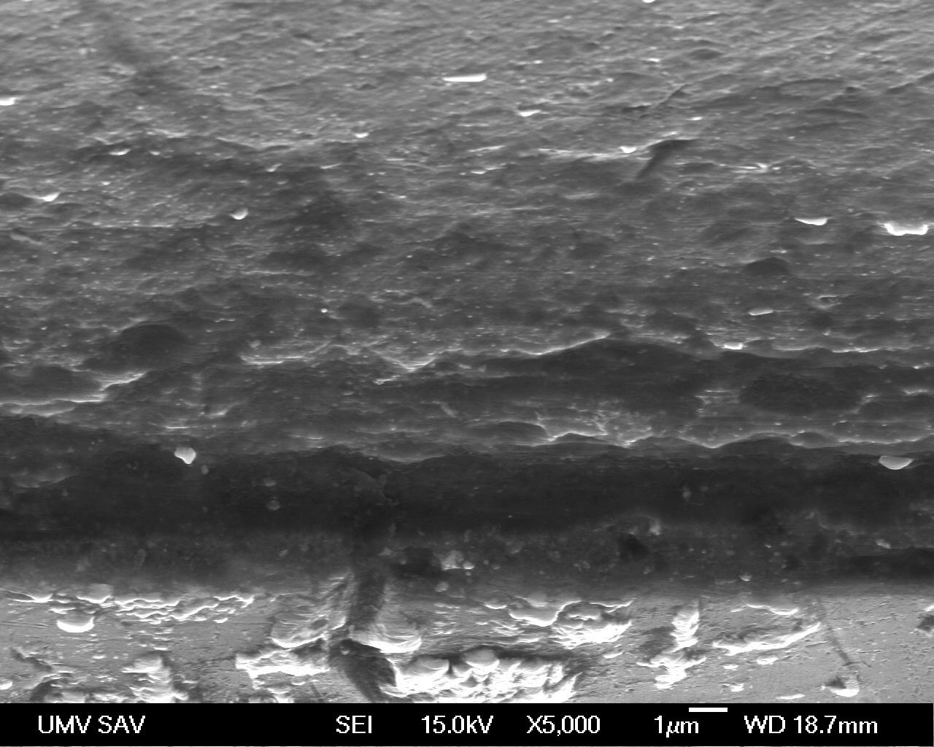
SEM/EDX
weld, tilt of the specimen 0°
Mg
Al
Al
weld, tilt of the specimen 70°
Element POINT: | Mg [wt. %] | Al [wt. %] | Si [wt. %] | Fe [wt. %] | Cu [wt. %] | O [wt.%]
1 | 6 | 27,3 | 0,4 | 34,1 | 32,2 | -
2 | 3,7 | 81,7 | - | 1,6 | 10,5 | 2,5
3 | 85,4 | 11,7 | 0,2 | - | - | 2,7
4 | 88,9 | - | 0,7 | - | 1,2 | 9,2
5 | 95,4 | - | - | - | - | 4,6
Al
Notes:
Chemical analysis of the interface was determined by 5 measurements randomly placed on the interface line which are depicted on the top and right side of the slide. As the table shows, the welded interface exhibit chemical heterogeneity.
On the left side of you can see again the morphology of the welded joint in detail - at the maginication of 4000X at the top – without titl and at the magnification of 5000X at the bottom – with tilt of 70°where morphology can be seen better

Slide 9
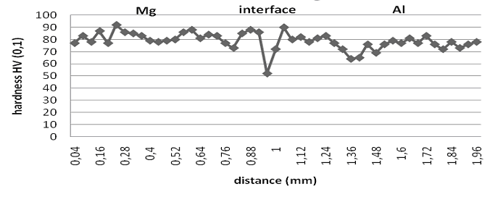
Micro - hardness
step: 120 microns
micro - hardness of the joined materials measured far from their interface is similar for both materials
in the region of interface the hardness drops down by 40% to about 50 HV0.1
Notes:
Now let´s move on to Micro-hardness. Micro-hardness of the wavy bond and joined materials itself was tested by LECO Microhardness test machine with step of 120 μm. If you look at thhis graph you can seen that hardness of the joined materials measured far from their interface is similar for both materials, for Mg it is about 80 HV0.1, and for Al ~ 75 HV0.1 (Fig. 5). However in the region of interface the hardness drops down by 40% to about 50 HV0.1 indicating some kind of thermal induced microstructure relaxation.
These results confirm <aur> our assumption that <moust> most important changes of materials are taking place at the interface.
HV 0.1 = 0.9807N

Slide 10
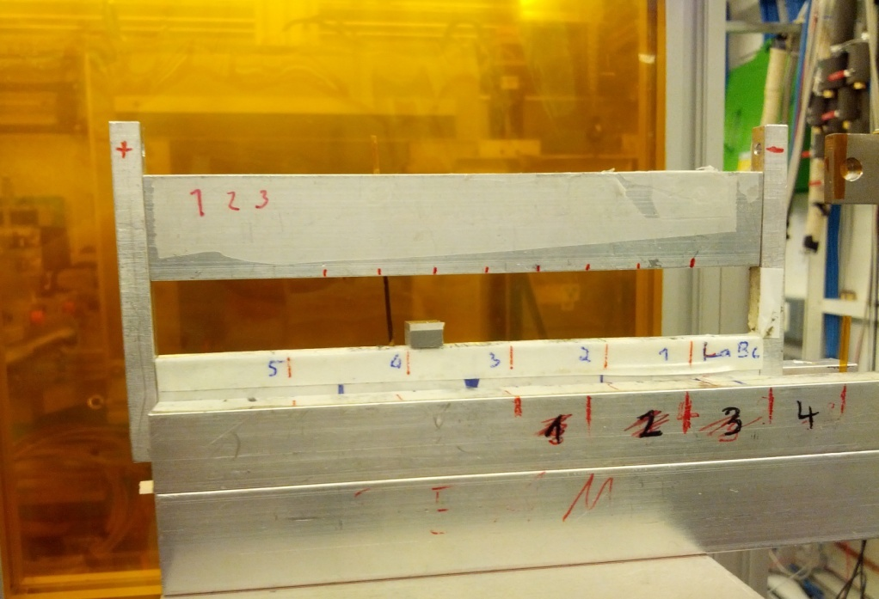
Hard X-ray micro-diffraction experiment
beam size: 2,2 x 34 μm
E= 99 keV
251 2D XRD patterns
Notes:
This leads me to my next point. Possible phase transformations at the interface was examined <ikzemint> by a hard X-ray micro-diffraction experiment performed at beamline P07 at PETRA III synchrotron <synkrotron> at DESY, in Germany. Monochromatic synchrotron radiation of energy 99 keV was used.
The beam of photons was focused <fouksd> by compound refractive lenses down to a spot size of 2.2 μm x (times) 34 μm. Schematic illustration of microdiffraction experiment is shown on the left side. The specimen was scanned <skand> shot-by-shot along a straight path passing from Mg to Al across their interface. In total we collected 251 2D XRD patterns recorded from individual places separated by 4 microns distance. We needed to find out, which scans belong to magnesium, aluminium and interface... →

Slide 11
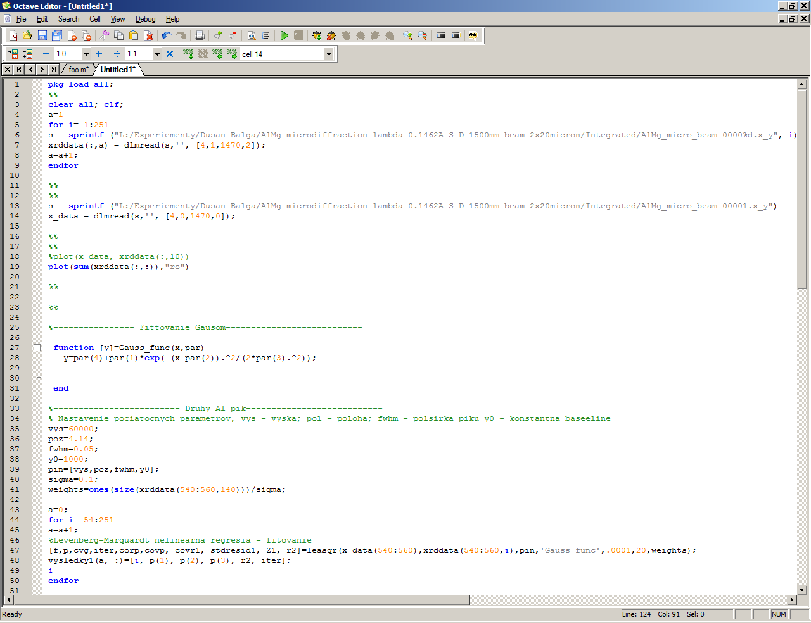
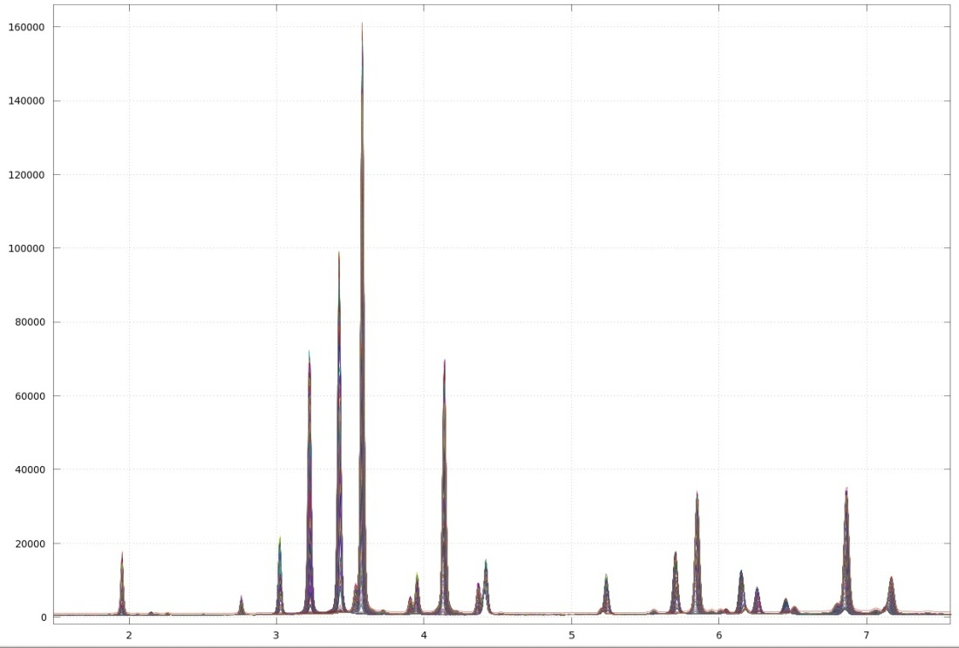
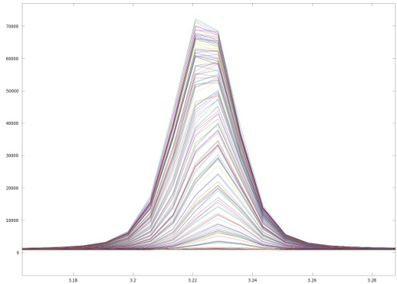
Notes:
So All data from scans were transfered to Ocatve computation software which environment you can see on the pictures and from the data it was depicted total scattering from all the peaks.
→
From this graph we found out , that scans 1-54 belongs to Mg, 54-142 belongs to weld and scans from 143-251 Aluminium. Jednotlivé časti boli fázovo analyzované prostredníctvom nástroja CMPR a zistila sa prítomnosť nasledovných fáz:

Slide 12
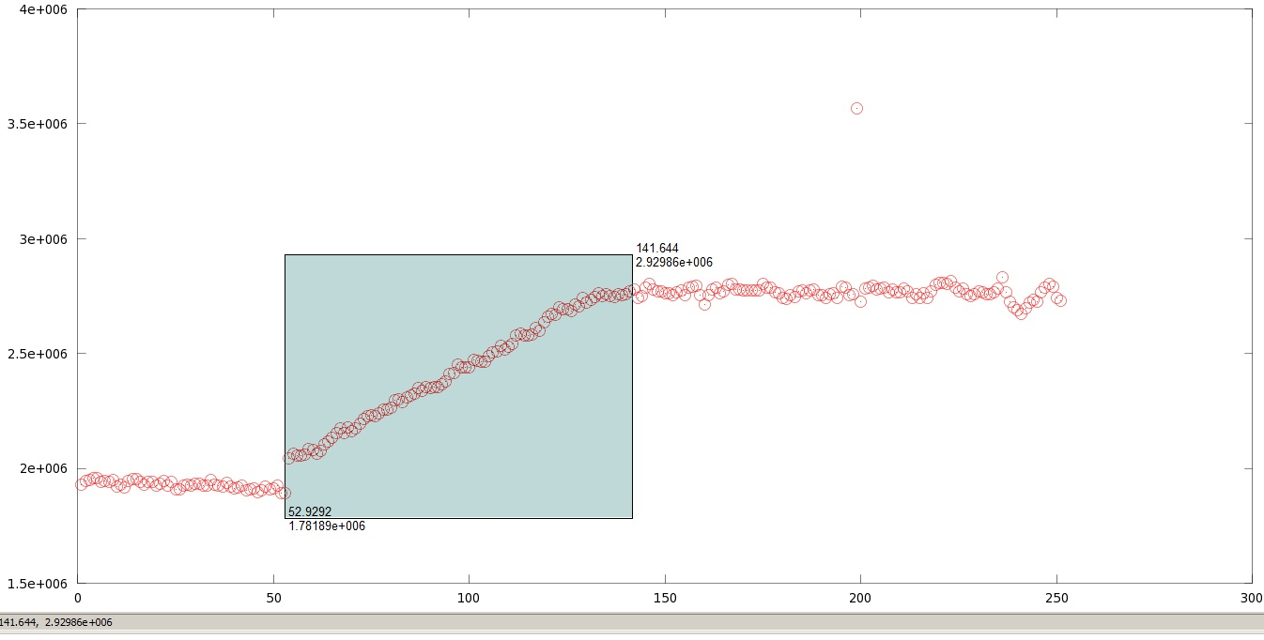
weld
Al
Mg
Notes:
All data from scans were transfered to Ocatve computation software which environment you can see on the pictures and from the data it was depicted total scattering from all the peaks.
→
And from this graph we found out , that scans 1-54 belongs to Mg, 54-142 belongs to weld and scans from 143-251 to Aluminium.

Slide 13
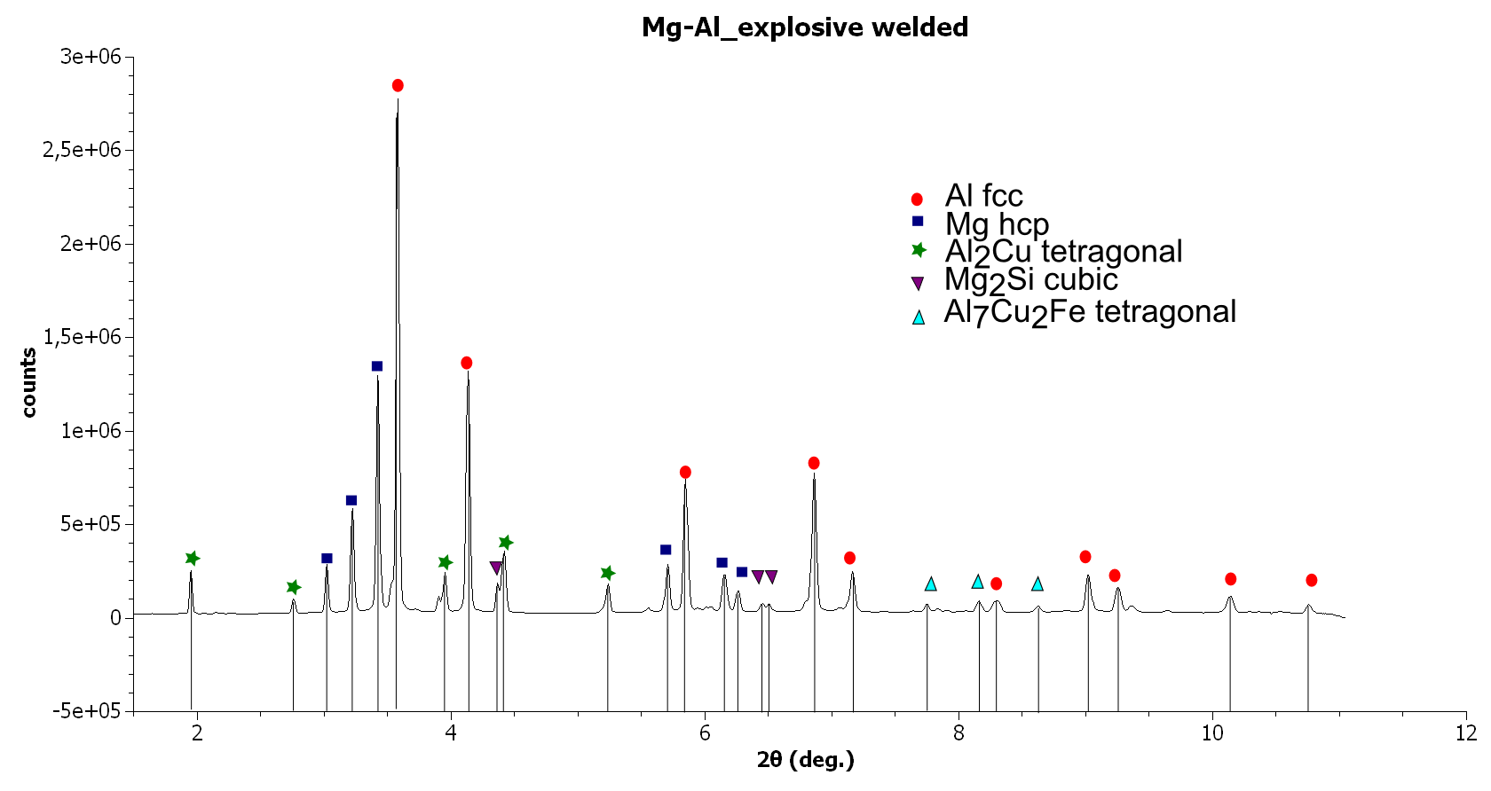
Phase analysis
Notes:
From the diffraction patterns we identified phases using the CMPR toolkit. In aluminium part far from the interface we found phase composition consisting of cubic -Al, Al2Cu tetragonal and Al7Cu2Fe tetragonal, phases. In magnesium part we found hexagonal Mg and Mg2Si cubic phases.
This picture on the slide illustrates phase analysis from interface region. At the interface we haven't observed any new intermetallics. Very interesting was the computation of lattice parameters and profiles of Al and Mg peaks which proved existence of solid solution with different chemical composition.
→

Slide 14
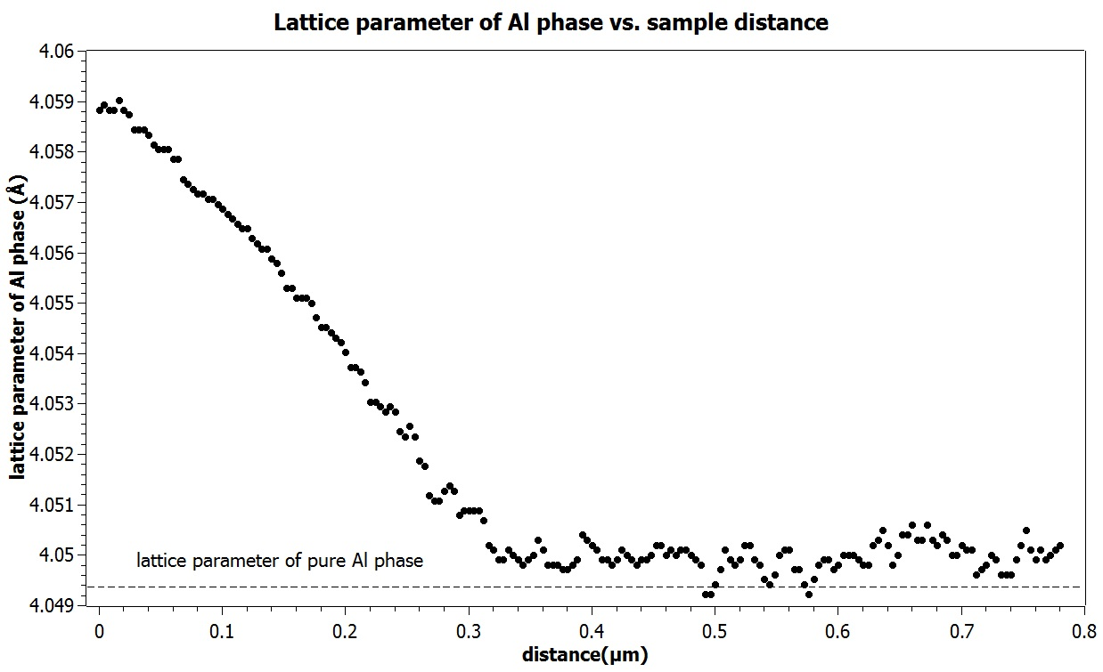
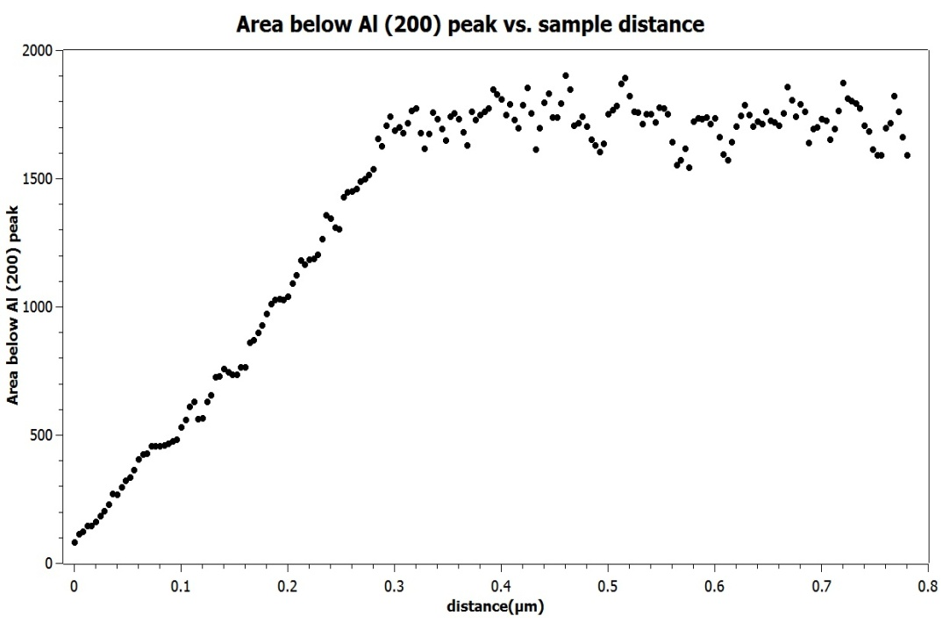
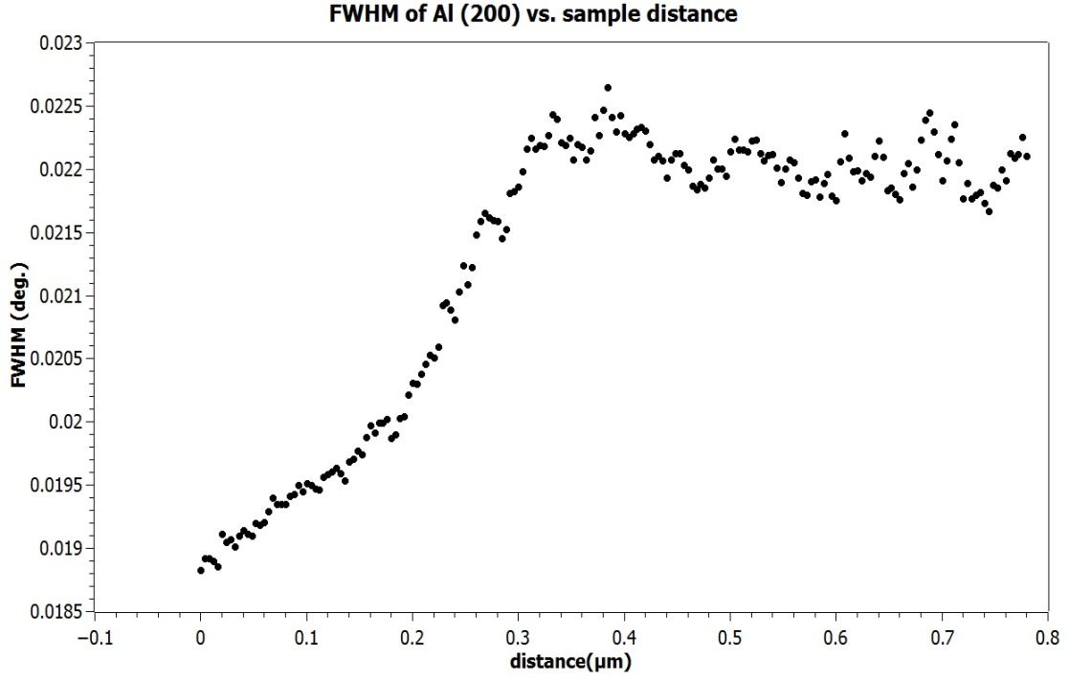
Al
Notes:
Ar. polomer hliníka: 1.431
horčíka:1.6
In all graphs, point represents the start of the welded joint. If you look at the picture at the top which is lattice parameter of Aluminium, you can see that at the beginning it is significantly bigger (0.2%) compared to the pure Al phase. This is due to the diffusion of larger Mg phase to the lattice of Al. With increased distance from the interface the lattice parameter gradually decreases to the value of pure Al phase. With increased distance, the cubic lattice becomes more and more enriched by Al atoms what is nicely demonstrated by increased Al (200) peak area. Full width at half maximum (FWHM) of the peak increases testifying crystalline size reduction and increased lattice deformation by going from the interface to aluminium.

Slide 15
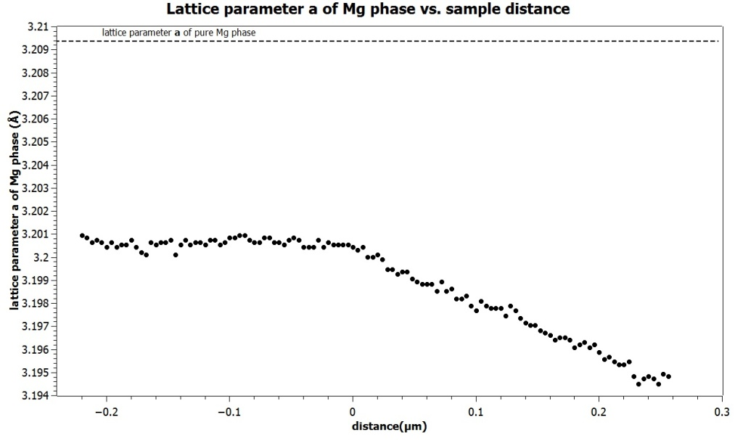
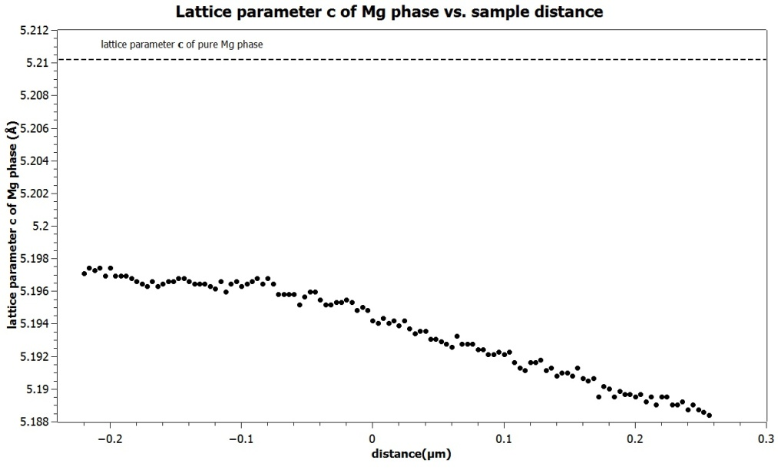
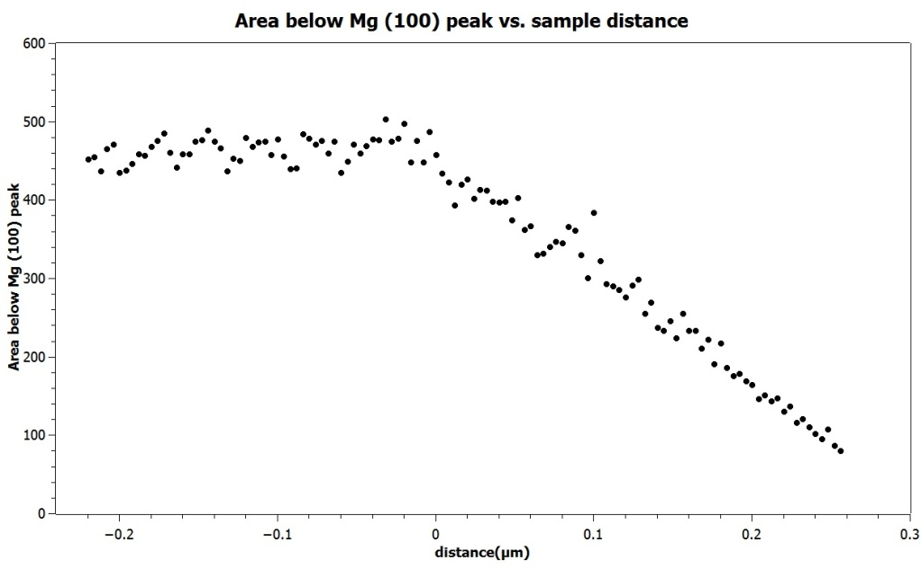
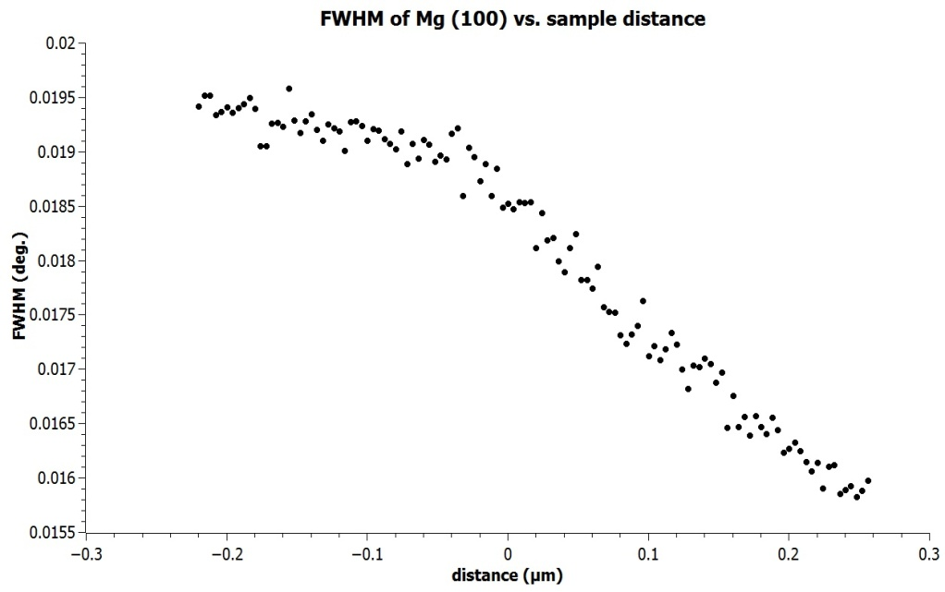
Mg
Notes:
For the case of Mg, Al with smaller atomic radius is penetrating to the lattice of Mg manifested by lattice parameter decrease how we can see on the 2 top graphs. With more Al atoms in the Mg lattice area bellow Mg peak decreases what illustrates left graph on the bottom.
How we can see from the FWHM parameter decrease, there is less failures incorporated at Mg matrix measured closer to the boundary, likely caused by the effect of thermal induced material relaxation.
So this information brings us to the end of the final section. Now, if I can just summarise <sammrrajz> the main points again.

Slide 16
Conclusion
  the results of metallographic and microchemical analysis showed that a wavy Al / Mg explosive welded interface is molten in a very thin (45 μm wide) region
  in the welded bond, there is substantial chemical inhomogeneity
  hardness in the middle of the Al / Mg interface region drops down by 40% from ~80HV0.1 to ~ 50 HV0.1 indicating some kind of thermal induced microstructure relaxation
  at the interface no intermetallics were observed
  we proved an existence of solid solution with gradually changed chemical composition from the centre of weld to the material

Slide 17
Acknowlegements
Ing. Karel Saksl, DrSc.
Institute of Materials Research SAV,
Slovak republic
prof. Ing. Eva Mazancová, CSc.
Ing. Dmytro Ostroushko
VŠB – Technical University of Ostrava,
Czech republic
the staffs at Beamline P07 – PETRA III, HASYLAB (DESY) – Germany for technical support during experiment
Explomet Company
Slovak Grant Agency for Science
  Grant No. 2/0128/13
Ministry of Education, Youth and Sports of Czech Republic
  project No. L01203 "Regional Materials Science and Technology Centre – Feasibility program“
  project MK 9333413 No. 02613/2013/RRC “International research teams”
Notes:
I would like to express my thanks to some people and institutions: thanks to ........
Thanks also to Slovak Grant Agency for Science and Ministry of Edication, Youth and Sport of Czech republic for financial support

Slide 18


THANKS FOR YOUR
ATTENTION
Slovak Academy of Sciences
Institute of Material Research
Kosice, Slovakia

